Slide 1
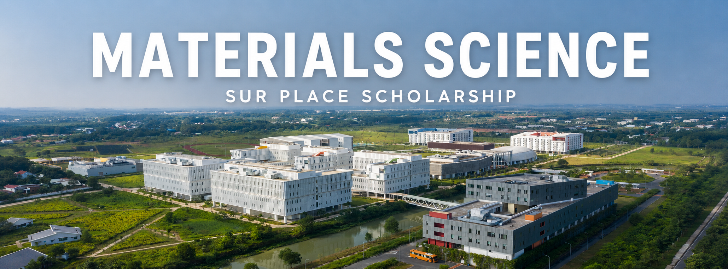


YOUR OPPORTUNITY AT VIETNAMESE-GERMAN UNIVERSITY
This scholarship supports talented Materials Science students directly at Vietnamese-German University. It is designed for students who want to strengthen their academic profile, deepen their scientific skills and become part of an international German-Vietnamese academic environment within their study program at VGU.
KEY FACTS
TYPE: On-site scholarship at VGU
DURATION: 12 months
TARGET GROUP: Motivated students with strong academic potential
SELECTION:
Quality-based and transparent selection
FOCUS: Academic progress, research orientation and international exchange

Slide 2
WHY SHOULD YOU APPLY?
FOCUS ON YOUR STUDIES
  Receive support that helps you to concentrate on your Materials Science education and academic develpoment at VGU
DEVELOP AS A RESEARCHER
  Engage with scientific questions, research methods and material-related challenges in a structured academic setting.
BUILD AN INTERNATIONAL PROFILE
  Benefit from the German-Vietnamese University network and strengthen your perspective for future study, research or career parts.
WHO ARE WE LOOKING FOR?
IDEAL CANDIDATE PROFILE
  Curious, reliable and committed students who are enthusiastic about Materials Science, open to academic exchange and willing to take an active role in their learnig and research environment.
Eligibility requirements
  Enrolled in Materials Science study program at VGU
  Good to excellent academic performance
  Strong interest in scientific research
  Good to excellent English language skills
  Social or cultural engagement is a plus

Slide 3


